Slide 1
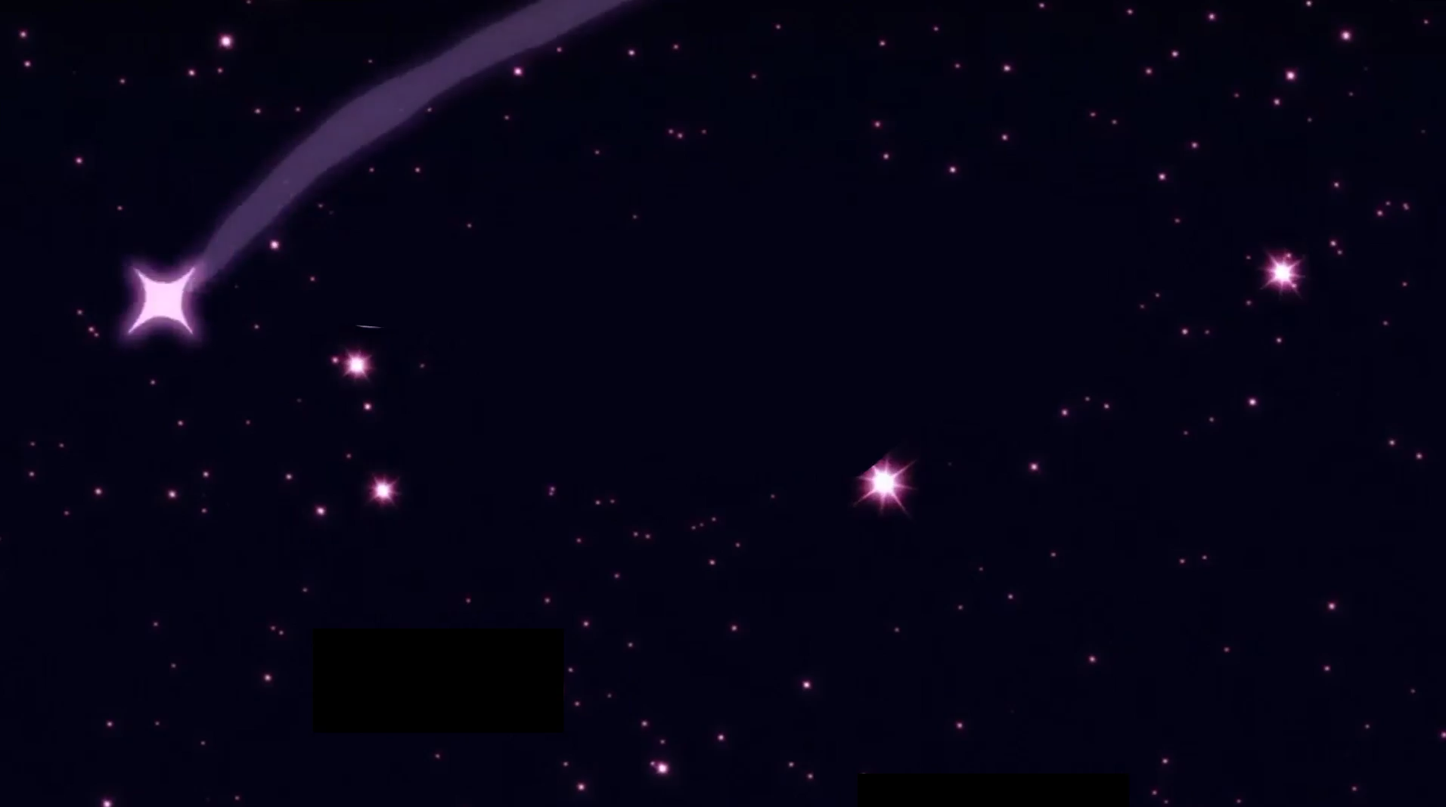

How to be

Slide 2

Being magnetic is not about making people obsessed with you...

Slide 3
…but rather, making them obsessed with themselves.

Slide 4
It’s about knowing what you want in life and attracting value-driven people.

Slide 5
Qualities

Slide 6


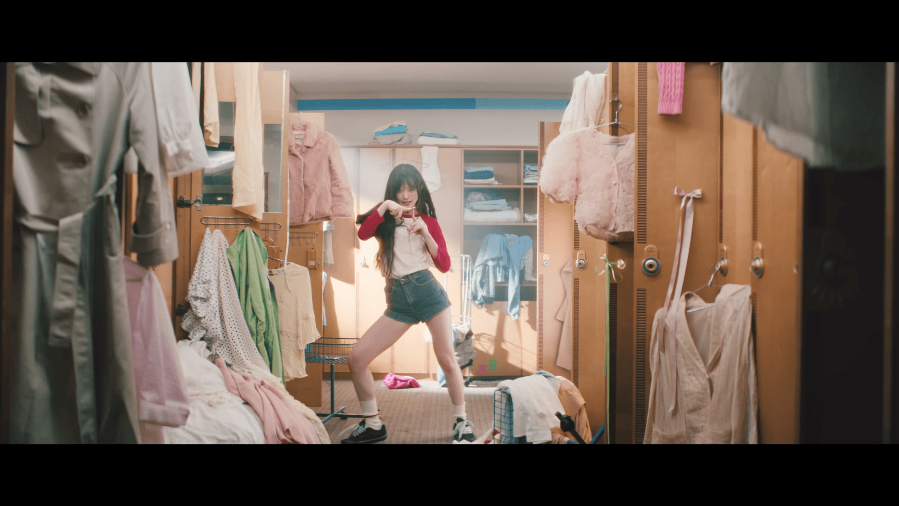

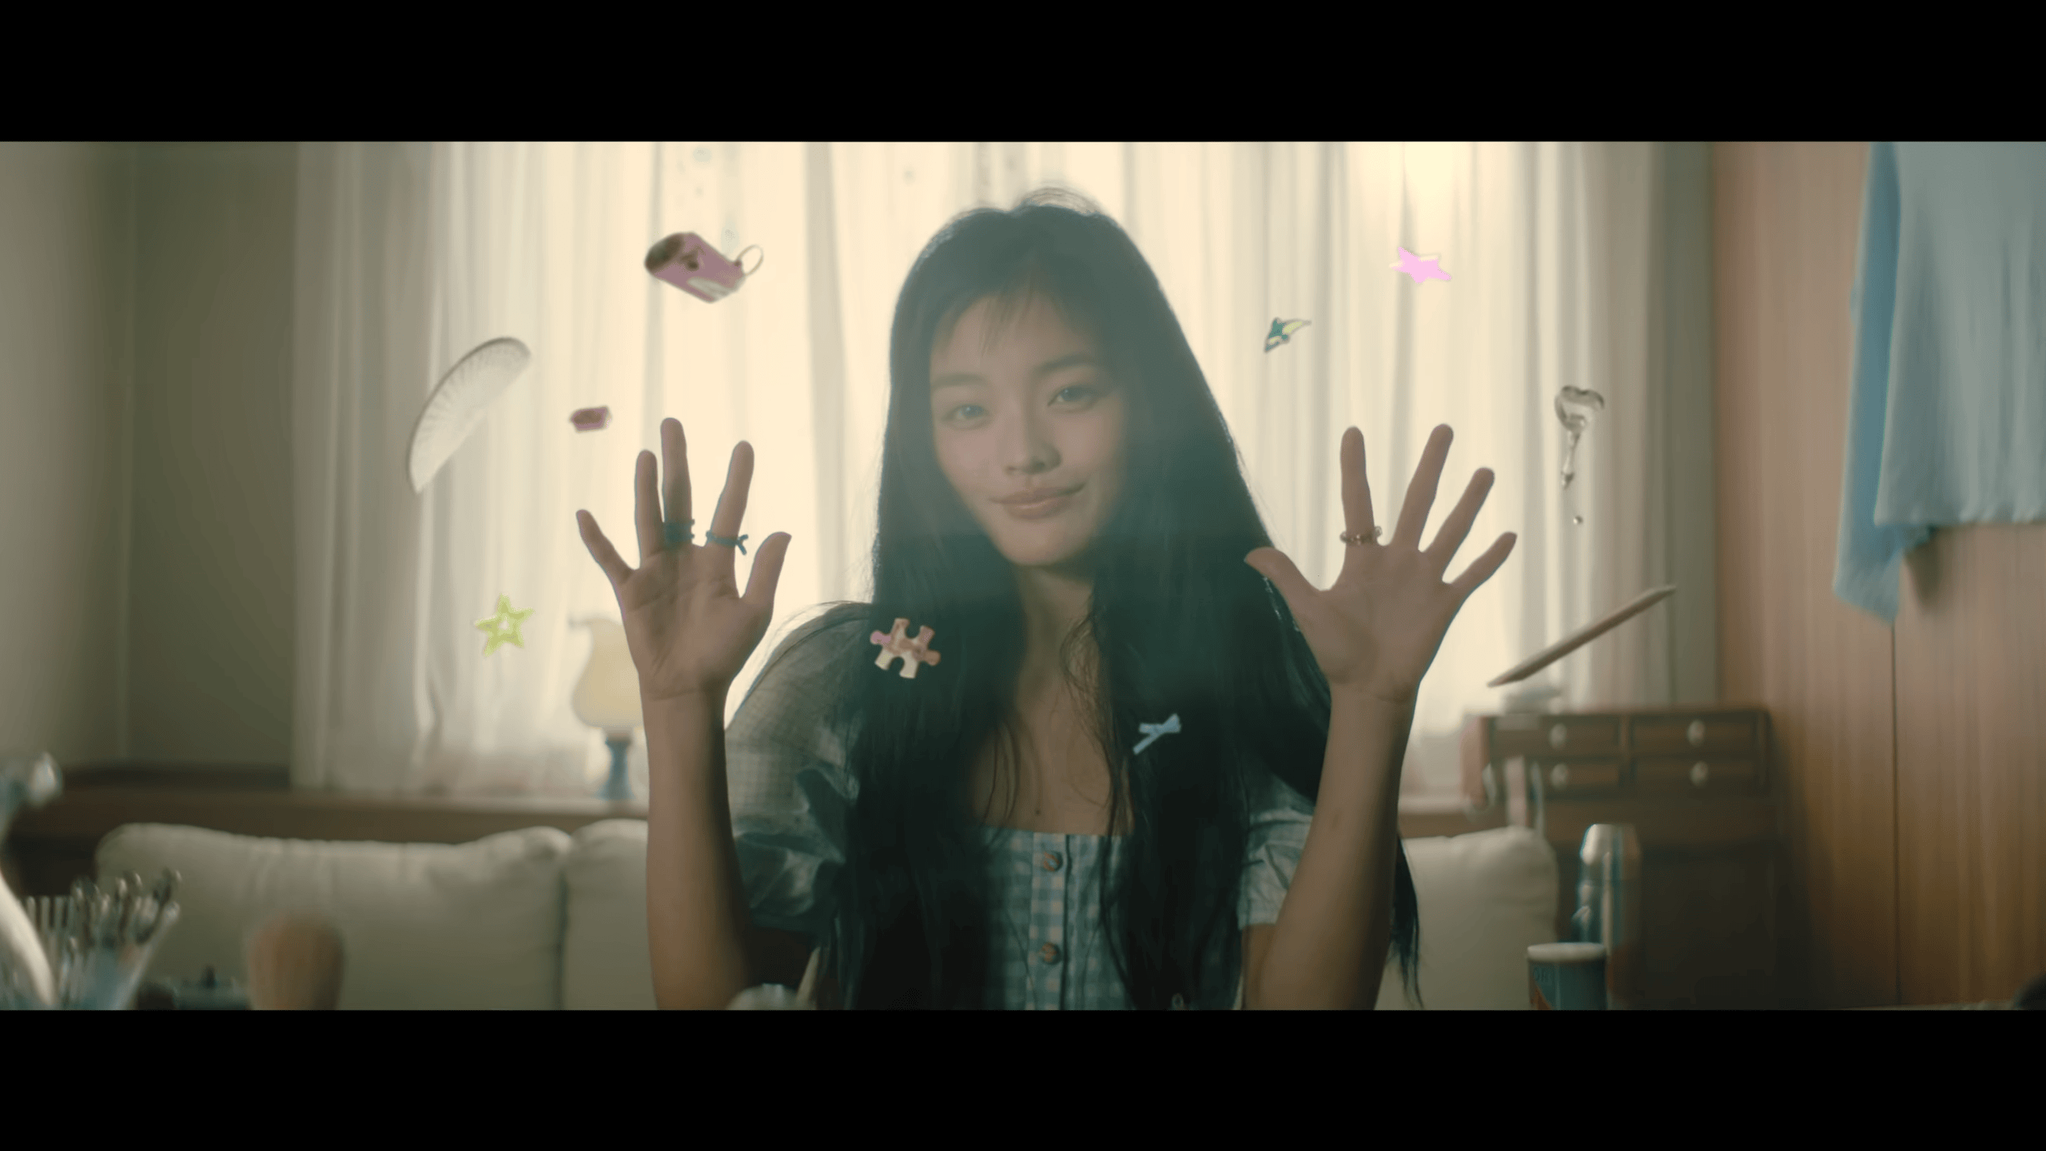
Focus on self-improvement and personal growth.
Continuous learning, seeking feedback for improvement, setting personal goals, and maintaining a positive attitude towards growth and change.
Be positive, empathetic, confident and genuine.
Show understanding and compassion towards others, be self-assured and competent, being genuine in you actions and show sincere interest in others can foster stronger, more authentic connections.

Slide 7
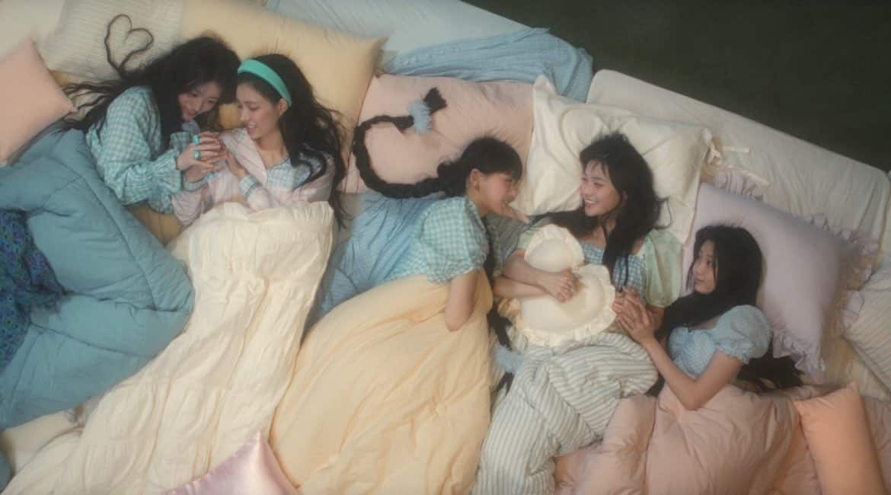
Focus on self-improvement and personal growth.
Continuous learning, seeking feedback for improvement, setting personal goals, and maintaining a positive attitude towards growth and change.
Be positive, empathetic, confident and genuine.
Show understanding and compassion towards others, be self-assured and competent, being genuine in you actions and show sincere interest in others can foster stronger, more authentic connections.
Maintain a balanced lifestyle.
Taking care of your physical health, managing stress, maintaining work-life balance, pursuing hobbies and interests, and investing time in personal relationships.

Slide 8
Be positive, empathetic, confident and genuine.
Show understanding and compassion towards others, be self-assured and competent, being genuine in you actions and show sincere interest in others can foster stronger, more authentic connections.
Maintain a balanced lifestyle.
Taking care of your physical health, managing stress, maintaining work-life balance, pursuing hobbies and interests, and investing time in personal relationships.

Slide 9
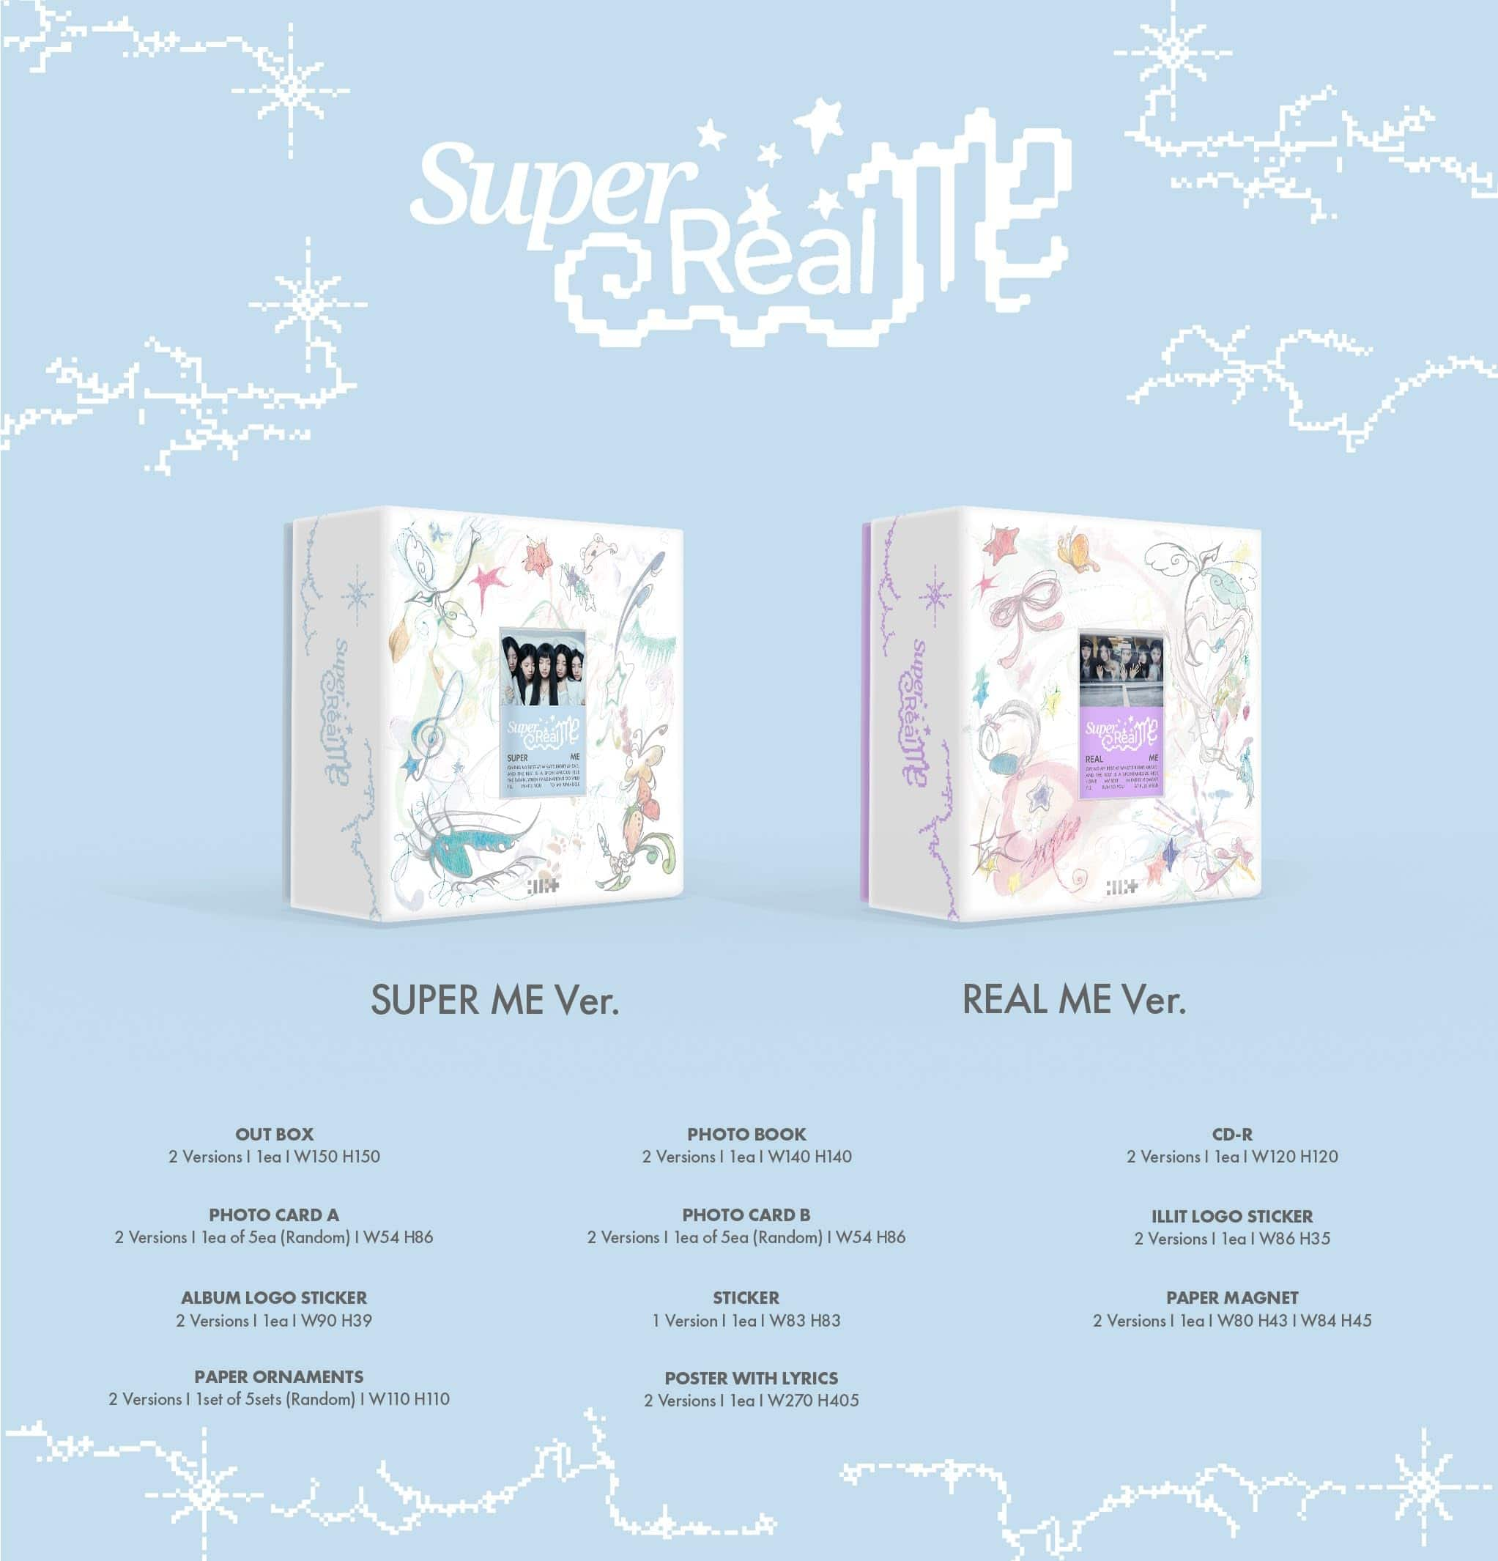
Just like magnets, we can attract or repel people based on our energy.
Positive energy attracts, while negative energy repels. Cultivate a positive mindset to attract the right people into your life.

Slide 10
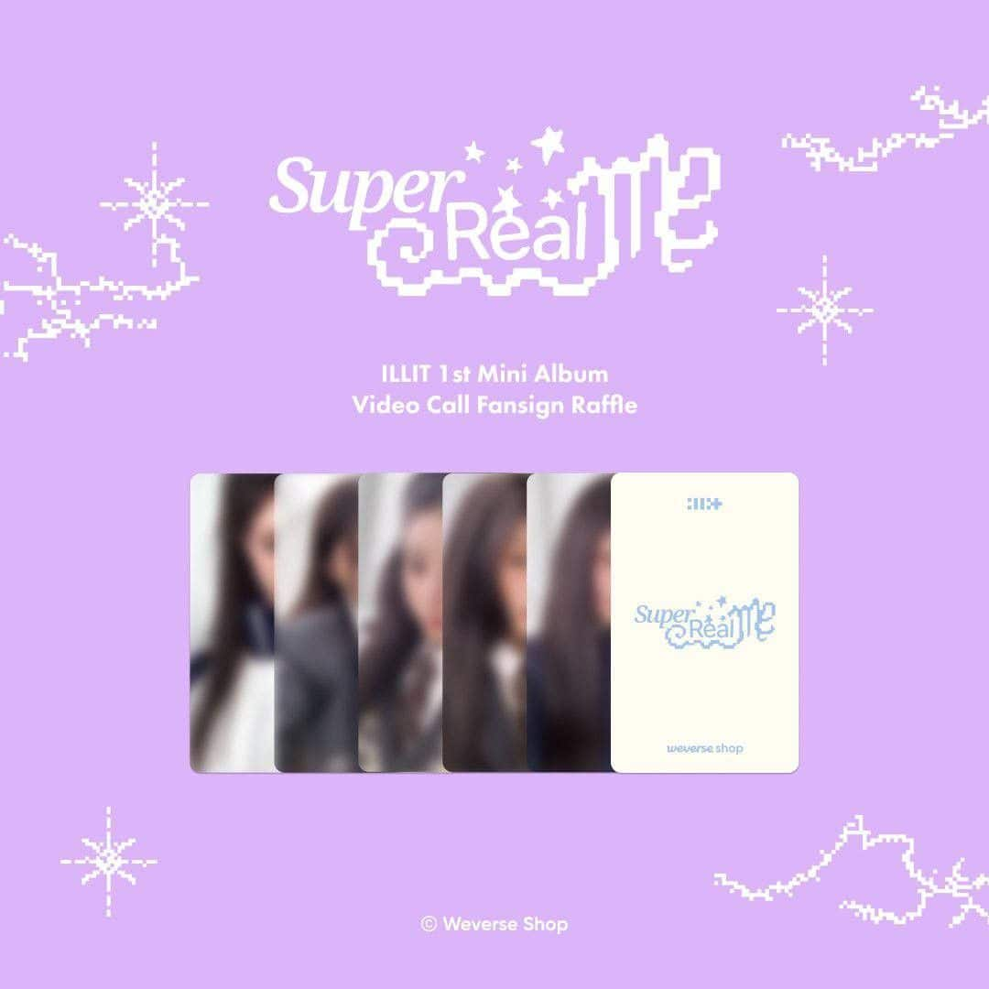
Creating excitement in your life and becoming the person you aspire to be can naturally attract the right people to you.

